Slide 1
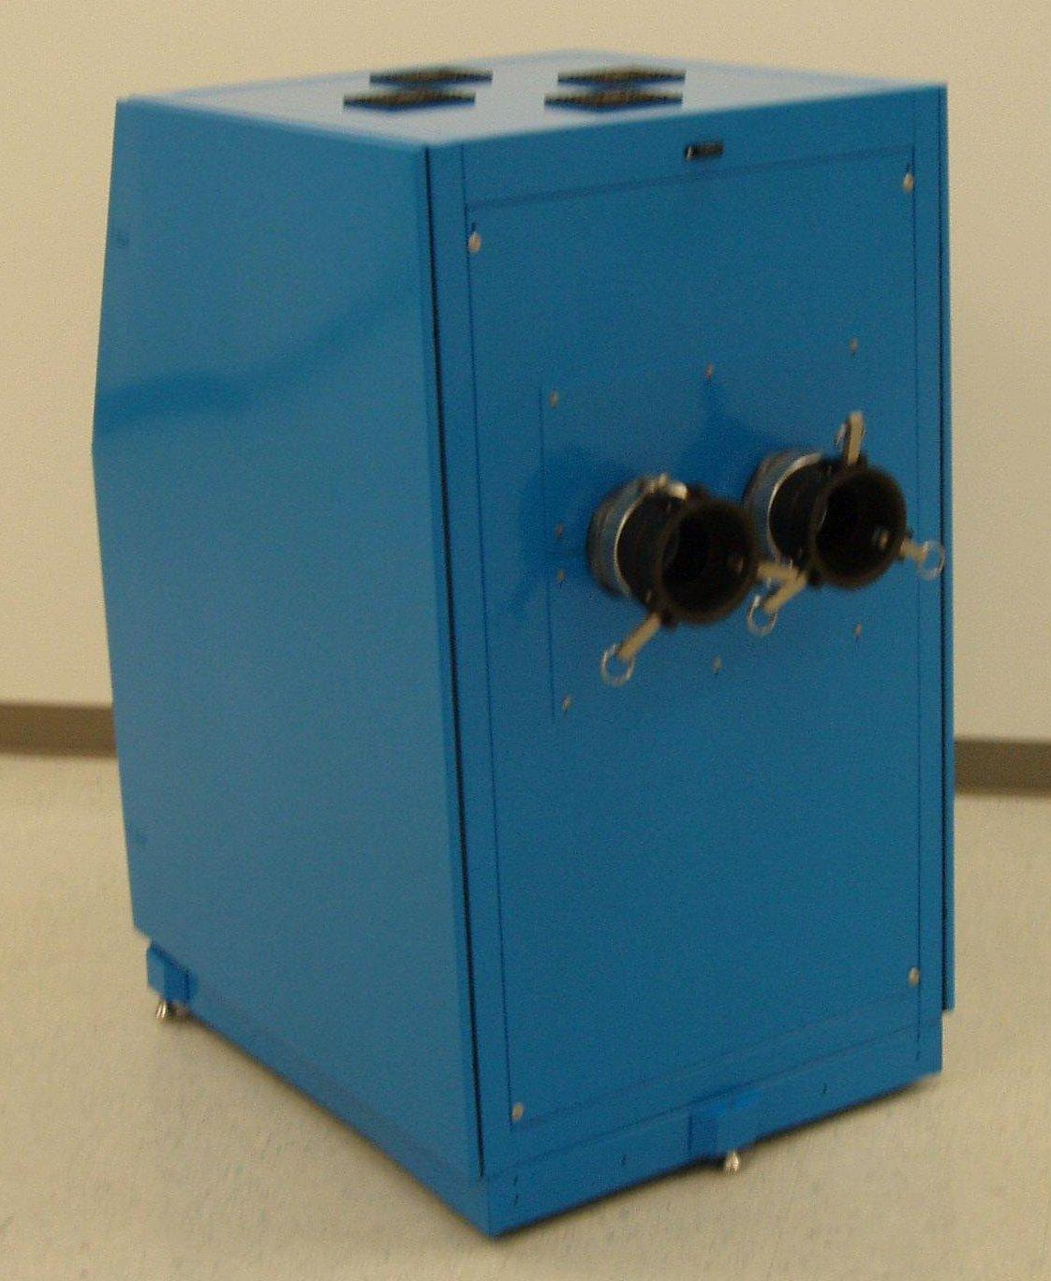
The Promise of Simple and Total Disinfection of Hospital Surfaces by Aerosolization of Peroxyacetic Acid
DENNIS G. MAKI, MD, AND MEGAN DUSTER, BS
University of Wisconsin School of Medicine and Public Health, Madison, WI
Dennis G. Maki, MD
dgmaki@wisc.edu
University of Wisconsin Hospital and Clinics—H4/572 600 Highland Ave.
Madison, WI 53792 608/263-1545
ICAAC Abstract K-2105 Poster 183
ABSTRACT
CONCLUSIONS
Background: Environmental surfaces contiguous to the patient, such as mattresses, bed rails, blood pressure cuffs, sink handles, and toilet seats, are frequently contaminated by MDR nosocomial pathogens, such as MRSA, VRE, Acinetobacter or C. difficile. Considerable data suggest that such contamination contributes to the acquisition of MDR pathogens by hospitalized patients, particularly in ICUs. It is difficult to achieve reliable disinfection of these surfaces by housekeeping personnel, especially manually, with standard hospital disinfectants. We report study of a novel approach to environmental disinfection in which an ultra-fine-particle aerosol of peroxyacetic acid is generated within a closed hospital room and allowed to dwell for a brief period, virtually sterilizing all surfaces within the room.
Methods: Unused patient care rooms were studied. Six 1-inch squares of multiple surfaces were inoculated with ~ 10⁴ cfu of 1 clinical isolate each of MRSA, VRE, A baumanii, P. aeruginosa or C. difficile; surfaces studied included the doorknob, plastic handrails, bedside table top, mattress, windowsill, cabinet door, dresser, sink, shower curtain, toilet seat and floor. After the inocula had dried overnight, 3 inoculated sites for each species on each surface was cultured quantitatively to determine baseline viability, following which the room was exposed to the peroxyacetic acid aerosol for 15 minutes; after purging the aerosol, the surfaces were allowed to dry for 1 hour and the remaining 3 inoculated squares for each species were cultured.
Results: Baseline pre-disinfection counts ranged from 102^{2.5} to 10^{4..5} (median, 10^{3.5}) cfu. None of the inoculated surfaces showed any detectable growth of any of the five test pathogens after aerosol disinfection.
Conclusions: This novel technology promises rapid, complete and safe decontamination of every exposed surface in a patient-care room as well as multi-use patient care items, such as sphygmomanometers, gurneys or wheelchairs, which are often disinfected in a desultory manner, if they are even regularly disinfected. The next step is to test this technology in a large clinical trial to ascertain whether periodic total disinfection of all surfaces in patient-care rooms can reduce the risk of nosocomial colonization and infection by MDR pathogens.
Although environmental surfaces within hospital rooms, particularly within ICUs, can be commonly shown to be heavily contaminated by major multidrug-resistant pathogens, such as MRSA, VRE, A baumanii, P aeruginosa or, especially, C. difficile, ^{1,2} scholarly reviews have disagreed whether microorganisms contaminating hospital surfaces pose significant risks to patients. ^{9,10} However, many epidemiologic studies using nucleic acid subtyping have convincingly linked contamination of hospital surfaces contiguous to patients to the continued nosocomial spread of MRSA,¹¹ VRE,¹² A baumanii, ³ HBV,¹⁴ HCV,¹⁵ norovirus ¹⁶ and, especially, C. difficile,^{17,18} and in a number of outbreaks, control measures failed abysmally until greatly augmented environmental disinfection procedures were implemented.
The novel technology we report, the use of a novel ultra-fine-particle aerosol of peroxyacetic acid, promises rapid, comprehensive and safe decontamination of every exposed surface in a patient-care room as well as multi-use patient care items such as a sphygmomanometers or stethoscopes, which are decontaminated in a desultory manner, if they are even regularly decontaminated. This technology or, perhaps, the use of hydrogen peroxide vapor disinfection holds the promise to determine once and for all in a large multicenter trial whether periodic complete disinfection of all surfaces in patient-care rooms can significantly reduce the incidence of nosocomial colonization and infection by MDR pathogens, especially MRSA, VRE, A baumanii, and C. difficile.
BACKGROUND
METHODS
Environmental surfaces contiguous to the patient, such as mattresses, bed rails, mattresses and bedding, doorknobs, blood pressure cuffs, sink handles, and toilet seats, can be shown to be frequently contaminated by MDR nosocomial pathogens, such as MRSA, Acinetobacter or C. difficile. and many epidemiologic studies suggest that such contamination contributes to the acquisition of MDR pathogens by hospitalized patients, particularly in ICUs.^{1,2}It is difficult to achieve reliable disinfection of these surfaces by housekeeping personnel, especially manually, with standard hospital disinfectants, which only rarely are sporicidal.
Aerosols – vapors – of chemical disinfectants which exhibit bactericidal and sporicidal activity hold the promise of achieving a far higher consistency and levels of surface disinfection than manual application of liquid agents. Machines which can generate a hydrogen peroxide vapor are now commercially available and have been shown to be highly effective in disinfecting hospital surfaces,³⁻⁵ however, require up to four times as long to decontaminate hospital room as housekeeping personnel applying a liquid disinfectant manually. ⁵
Peroxyacetic acid, produced by combining hydrogen peroxide and acetic acid, and which breaks down into non-toxic residues acetic acid, O₂ and water, has long been known to be a powerful chemical disinfectant which is highly bactericidal, viricial, fungicidal, mycobactericidal and sporicidal⁶but far less biologically toxic or corrosive to surface materials than glutaraldehyde or hypochlorite. As such, it is approved and considered safe by FDA (21 CFR 178.1005-1010) and EPA for use as a non-toxic sanitizer and disinfectant in the food industry, both for washing vegetables and cleansing food preparation surfaces. Recent studies have shown that it is a highly effective surface disinfectant when aerosolized; studies in a veterinary hospital showed rapid and high-level decontamination of heavily contaminated surfaces. ⁷
We report a pilot study of a novel approach to environmental disinfection in a human health care setting in which aerosolization of an ultra-fine-particle aerosol of peroxyacetic acid using a novel generator within a closed hospital room, allowed to dwell for a very brief period, sterilized all of the surfaces within the room.
The aerosol generator
The generator using these studies (Altapure, LLC, Tomahawk, WI) is a novel, patented technology that generates an ultra-fine aerosol of particles ranging in size from <1 to 3 µ in diameter which diffuse into and penetrate every microscopic interstice of a solid or a fabric surface.
Microbial isolates
In this study, single clinical isolates each of MRSA, VRE, Acinetobacter baumanii, Pseudomonas aeruginosa, and Clostridium difficile obtained from the Microbiology Laboratory of the
University of Wisconsin Hospital and Clinics were purified and their identities reconfirmed. Twenty-four-hour cultures in trypticase soy broth (Remel Inc,, Lenexa, KS ) were diluted to a 0.5 McFarland standard and further diluted to achieve a working stock solution containing approximately 7.5x10⁴ cfu per mL, which were maintained at 4° C. until used. A defined concentration of C. difficile spores was obtained using ethanol treatment of a 48-hour anaerobic culture of the stock strain and serial dilutions. ⁸
Studies in hospital rooms
Unused hospital rooms on a patient care unit scheduled for upcoming renovation were employed for the study. Six 1-inch squares on each of 12 multiple surfaces were inoculated with 100 µL ( ~ 10³⁻⁵ cfu) of 1 clinical isolate each of MRSA, VRE, A baumanii, P. aeruginosa and C. difficile. The surfaces studied included the bed headboard, plastic handrails, bedside table, mattress, windowsill, cabinet door, bedside dresser, toilet seat, sink basin, tile floor, doorknob and shower curtain.
After the inocula had dried overnight, three inoculated sites for each microorganism on each surface were cultured semi-quantitatively to determine baseline viability of the inoculum, using a premoistened cotton swab (BBL), which was immersed in 5 mL of trypticase soy broth (Remel) containing neutralizers and vortexed for 20 seconds, following which serial dilutions were cultured. After obtaining the baseline pre-disinfection cultures, the inoculated room was exposed to the peroxyacetic acid aerosol for 23 minutes, following which the aerosol was rapidly purged using a humidifier; and the surfaces were allowed to dry for 30 minutes, following which the remaining three inoculated squares on each surface type were cultured to determine the numbers of surviving microorganisms.
REFERENCES
1. Hota B. Contamination, disinfection, and cross-colonization: are hospital surfaces reservoirs for nosocomial infection? Clin Infect Dis. Oct 15 2004;39(8):1182-1189.
2. Boyce JM. Environmental contamination makes an important contribution to hospital infection. J Hosp Infect. Jun 2007;65 Suppl 2:50-54.
3. Johnston MD, Lawson S, Otter JA. Evaluation of hydrogen peroxide vapour as a method for the decontamination of surfaces contaminated with Clostridium botulinum spores. J Microbiol Methods. Mar 2005;60(3):403-411.
4. French GL, Otter JA, Shannon KP, Adams NM, Watling D, Parks MJ. Tackling contamination of the hospital environment by methicillin-resistant Staphylococcus aureus (MRSA): a comparison between conventional terminal cleaning and hydrogen peroxide vapour decontamination. J Hosp Infect. May 2004;57(1):31-37.
5. Boyce JM, Havill NL, Otter JA, et al. Impact of hydrogen peroxide vapor room decontamination on Clostridium difficile environmental contamination and transmission in a healthcare setting. Infect Control Hosp Epidemiol. Aug 2008;29(8):723-729.
6. Baldry MG. The bactericidal, fungicidal and sporicidal properties of hydrogen peroxide and peracetic acid. J Appl Bacteriol. Jun 1983;54(3):417-423.
7. Patterson G, Morley PS, Blehm KD, Lee DE, Dunowska M. Efficacy of directed misting application of a peroxygen disinfectant for environmental decontamination of a veterinary hospital. J Am Vet Med Assoc. Aug 15 2005;227(4):597-602.
8. Clabots CR, Gerding SJ, Olson MM, Peterson LR, Gerding DN. Detection of asymptomatic Clostridium difficile carriage by an alcohol shock procedure. J Clin Microbiol. Oct 1989;27(10):2386-2387.
9. Dettenkofer M, Wenzler S, Amthor S, Antes G, Motschall E, Daschner FD. Does disinfection of environmental surfaces influence nosocomial infection rates? A systematic review. Am J Infect Control. Apr 2004;32(2):84-89.
10. Dettenkofer M, Spencer RC. Importance of environmental decontamination--a critical view. J Hosp Infect. Jun 2007;65 Suppl 2:55-57.
11. Dancer SJ. Importance of the environment in meticillin-resistant Staphylococcus aureus acquisition: the case for hospital cleaning. Lancet Infect Dis. Feb 2008;8(2):101-113.
12. Martinez JA, Ruthazer R, Hansjosten K, Barefoot L, Snydman DR. Role of environmental contamination as a risk factor for acquisition of vancomycin-resistant enterococci in patients treated in a medical intensive care unit. Arch Intern Med. Sep 8 2003;163(16):1905-1912.
13. Scott P, Deye G, Srinivasan A, et al. An outbreak of multidrug-resistant Acinetobacter baumannii-calcoaceticus complex infection in the US military health care system associated with military operations in Iraq. Clin Infect Dis. Jun 15 2007;44(12):1577-1584.
14. Maynard JE. Nosocomial viral hepatitis. Am J Med. Feb 1981;70(2):439-444.
15. Girou E, Chevaliez S, Challine D, et al. Determinant roles of environmental contamination and noncompliance with standard precautions in the risk of hepatitis C virus transmission in a hemodialysis unit. Clin Infect Dis. Sep 1 2008;47(5):627-633.
16. Barker J, Vipond IB, Bloomfield SF. Effects of cleaning and disinfection in reducing the spread of Norovirus contamination via environmental surfaces. J Hosp Infect. Sep 2004;58(1):42-49.
17. Mayfield JL, Leet T, Miller J, Mundy LM. Environmental control to reduce transmission of Clostridium difficile. Clin Infect Dis. Oct 2000;31(4):995-1000.
18. McMullen KM, Zack J, Coopersmith CM, Kollef M, Dubberke E, Warren DK. Use of hypochlorite solution to decrease rates of Clostridium difficile-associated diarrhea. Infect Control Hosp Epidemiol. Feb 2007;28(2):205-207.
RESULTS
Experiments were done in two rooms, with an aerosol containing 0.88% hydrogen peroxide and 0.12% of peroxyacetic acid. The aerosol was generated for eight minutes, following which it was allowed to dwell for 15 minutes (during which the room temperature ranged from 62 to 65° C. and humidity rose from 31 to 92%), following which the aerosol was evacuated with a humidifier.
Baseline counts ranged from 10^{2.5} to 10^{4.5} (median, 103^{3.3}) on the various surfaces. None of the inoculated surfaces showed any detectable growth of any of the five test pathogens after aerosol disinfection.
Support: Supported by an unrestricted grant for research in infection control from the Oscar Rennebohm Foundation of Madison Wisconsin.
Conflict of Interest Statement: Dr. Maki holds no personal financial interest in Altepure LLC. and has received no compensation for his participation in these studies. Ms. Duster has no conflicts of interest to report.

